Slide 1

QTM 151: Introduction to Statistical Computing II
Dr. Alejandro Sánchez Becerra

Slide 2
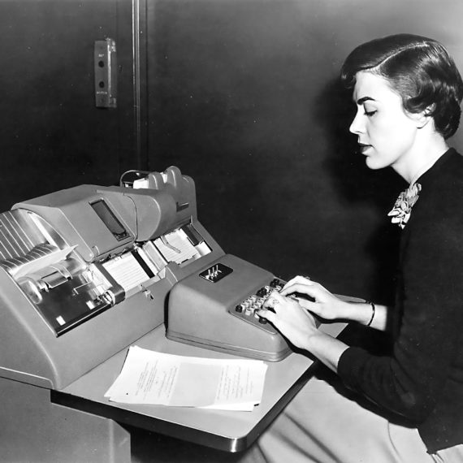
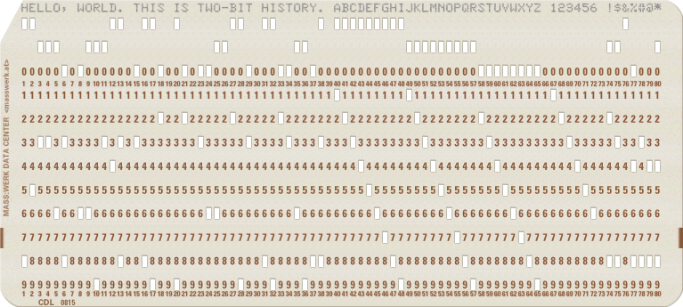
Notes:
Speaker Notes: Take a look at these two images. Can anyone tell what they are showing?

Slide 3
The person on the left is using a keyboard to create a punched card (right). Each hole was used to represent a character. You can see the line of code at the top.
Punched cards were fed into machines to run code
Were developed by IBM at least as far back as the 1920s, building on ideas from the 19th century
Huge cultural impact on 20th century programming
Used with machines of evolving sophistication
Source: https://www.monotype.com/resources/articles/the-past-present-and-future-of-machine-translation
Notes:
Speaker notes:
- Explain that it’s the same idea as feeding a credit card into an ATM
- ”It’s important to remember that information has always been valuable. Punch cards were used in all sorts of applications, from inventories in the railway system, to complex financial transactions, as well as telecommunications. Older professors still remember using punch cards to compute statistics.”

Slide 4
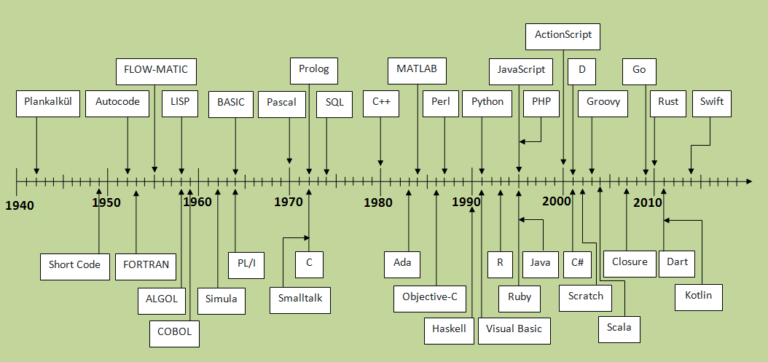
A History of Programming Languages
That’s us!
- More recent languages like Python tend to be ”high-level” in the sense that they are easier to read and produce interpretable output
Older languages tend to be
”low-level” in the sense that they are closer to “machine” code. They are still around either as a base for high-level languages, or for computing-intensive tasks because they tend to be faster.
There’s a whole spectrum
in between, e.g. C, C++
Source: https://javaconceptoftheday.com/history-of-programming-languages/

Slide 5

Source: https://www.wikiwand.com/en/Punched_card_input/output
- Punch cards were entered into the slot on the right
The back panels comprised a single computer
The computer would process the code and produce an output.
The whole process was very modular!

Slide 6



+
VS-Code:
An Interactive Development Environment (IDE)
“Our Machine to Read”
Python:
A language
“Tells the machine how to read”
Notebook/ Python Script:
A file with lines of code
“Our punch card with instructions”

Slide 7
Agenda
Learning objectives
Assignment and Quizzes
DIVE INTO PYTHON
Review of our Canvas page

Slide 8

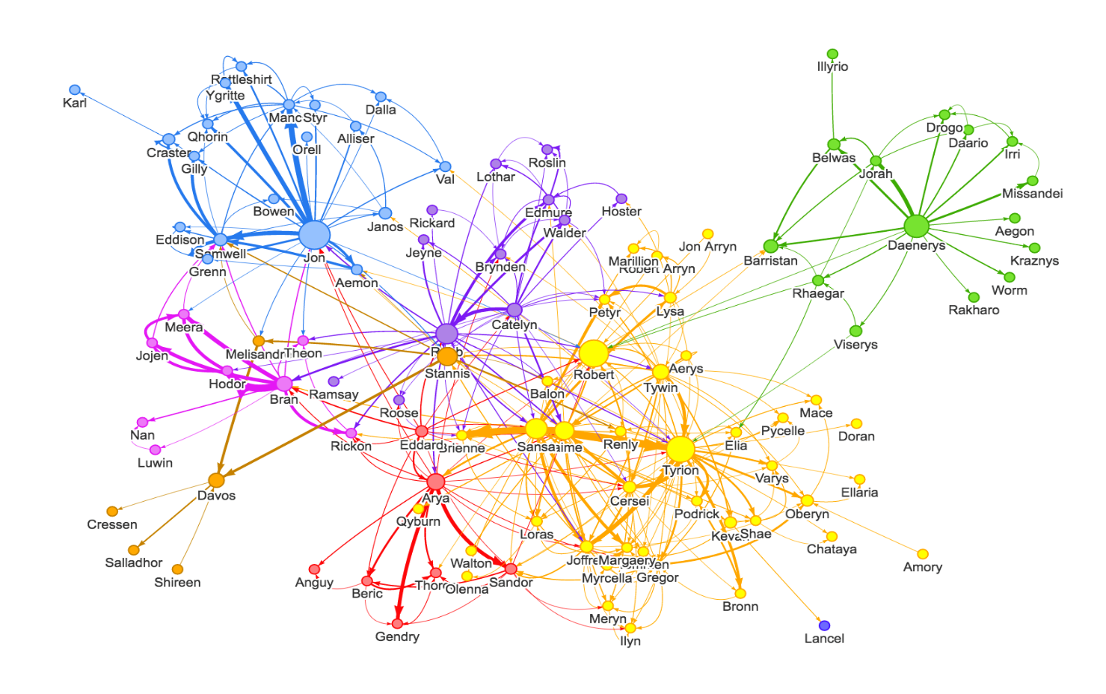
About me
My name is Alejandro Sanchez
I obtained a Ph.D. in Economics at the University of Pennsylvania and did a post-doc at New York University.
I’m originally from Colombia.
My research focuses on causal inference, machine learning, and network analyses. I contribute new methodologies to find the most effective programs to reduce poverty

Slide 9

+
VS-Code:
An Interactive Development Environment (IDE)
“Our Machine to Read”
Python:
A language
“Tells the machine how to read”
Notebook/ Python Script:
A file with lines of code
“Our punch card with instructions”
All the lecture notes will be available on Github
- See Assignment 2 for details on how to install.
Github Desktop
A file management system with version control. Great for collaboration

Slide 10

+
VS-Code:
An Interactive Development Environment (IDE)
“Our Machine to Read”
Python:
A language
“Tells the machine how to read”
Notebook/ Python Script:
A file with lines of code
“Our punch card with instructions”
+
Github Desktop
A file management system with version control. Great for collaboration
A database system
“How to store and access data”

Slide 11


+
VS-Code:
An Interactive Development Environment (IDE)
“Our Machine to Read”
Python:
A language
“Tells the machine how to read”
Notebook/ Python Script:
A file with lines of code
“Our punch card with instructions”
pgAdmin4:
An interactive program for managing data on servers
PostgreSQL:
A language to process databases on servers
Github Desktop
A file management system with version control. Great for collaboration

Slide 12
Coding Ability is not Innate
Coding ability can be developed.
Data analysis skills can be acquired.
Academic skills and abilities are acquired through hard work, mistakes, and perseverance.
My only goal here is that you learn the material. Please ask me questions!

Slide 13
Learning Objectives
Learn how to work efficiently in a collaborative setting
Understand the version control workflow using GitHub
Be familiar with cloud computing and other cloud solutions
Have a level of understanding of python that allows you to independently program using available resources
data types, control flow (if statements and loops), custom functions, object-oriented language, etc.
Being able to manipulate and analyze data using Python and SQL

Slide 14
Assignment and Quizzes
Assignments are 50% of the final grades. The assignments dates are all available already in Canvas.
We will be using GitHub classroom and AWS for the assignments starting from Assignment 3. I will explain how to use those technologies in our third class (9/01).
In-class quizzes are 30% of the final grade. You have access to the dates we will be conducting quizzes. In the quiz-days, we will take the las 20 minutes of class to solve the quizzes. I will have a practice quiz before Quiz 1 (9/20).
The final project is 20% of the final grade and it is due the last day o class. I will give you the details about the final exam at the start of Module 2.

Slide 15
Questions about the logistics

Slide 16








Before moving to GitHub
Workflow in your local computers
Classes 8/25 and 8/30
Workflow using cloud computing
Starting in class 9/01 on
QTM151
QTM151
Or any other code editor

